Slide 1
Predicting Facebook Engagement

Slide 2
Problem
Solution
Social media marketers don’t know what kind of Facebook posts give more engagement
No informed way to tell whether to spend money to advertise post, etc
Come up with a model that predicts engagement level based on certain parameters

Slide 3

Parameters
Target
Which weekday the post is
Time of the post
length of text (character count)
Format of post (video, photo, album, etc)
Whether the post is for a contest
Amplification: (Paid / Organic)
Time from the last post
Number of creatives (Photos, and videos, etc)
Share rate - (no. of shares) / (unique impressions)

Slide 4
Target Account - The Faceshop Singapore
We are only focussing on a single Facebook account
Because behaviour probably differs across domains

Slide 5
Data Extraction
Gathered and processed data from Facebook’s API (The Faceshop Singapore)

Slide 6
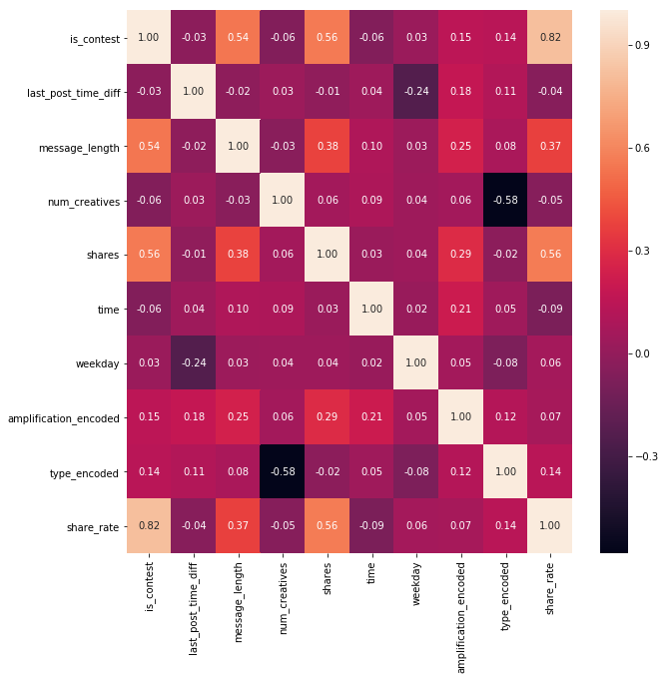
Data Exploration
(Correlation)

Slide 7
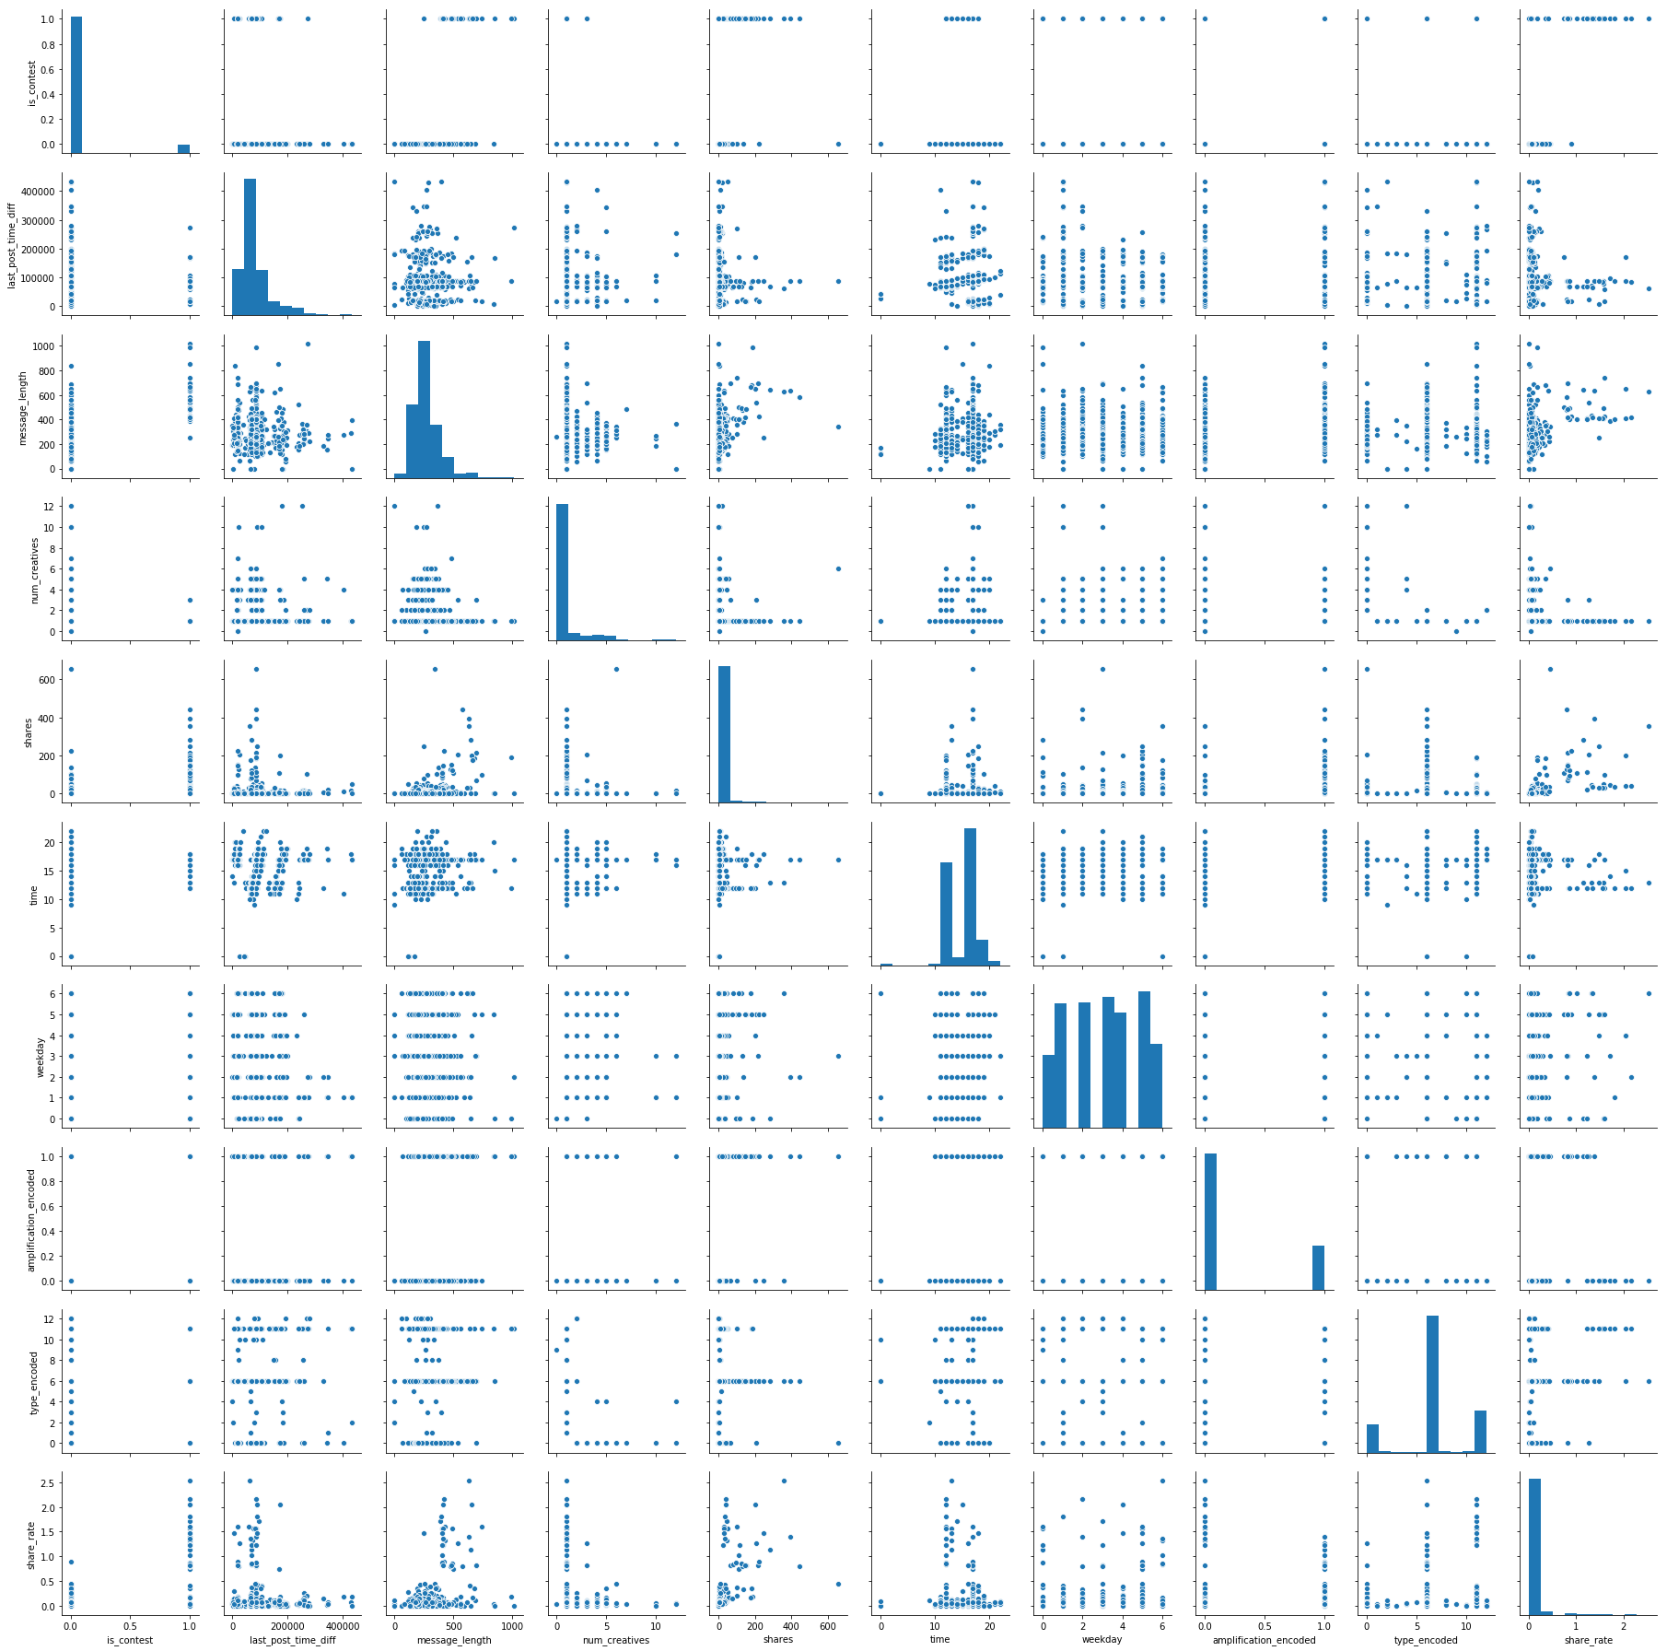
Data Exploration
(Pairplot)

Slide 8
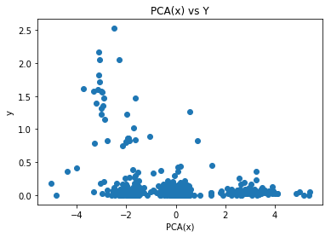
Data Exploration (1-D PCA(X) vs y)

Slide 9
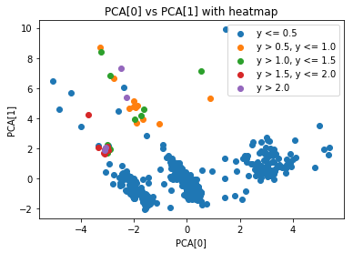
Data Exploration (2-D PCA(X) vs color coded y)

Slide 10
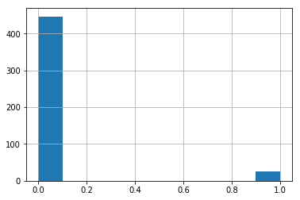
Oversampling
Contest vs non-contest is very unbalanced, so we oversampled the minority class to ⅕ of the majority class

Slide 11
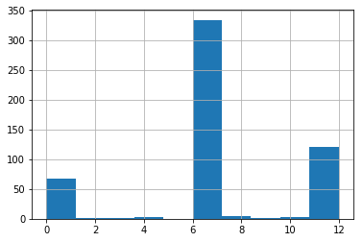
Undersampling
Content type is very unbalanced. We dropped the minority classes

Slide 12
Evaluation Metric
MAE, because the target values are inherently small:
0 0.129143 1 0.015949 2 0.127699 3 0.000000 4 0.192456 5 0.018033 6 0.000000 7 0.000000 8 0.000000 9 0.016786 10 0.000000

Slide 13
Models we considered….
SGDRegressor
SGDRegressor with Polynomial Transformation
MLP
Word Embeddings with MLP

Slide 14
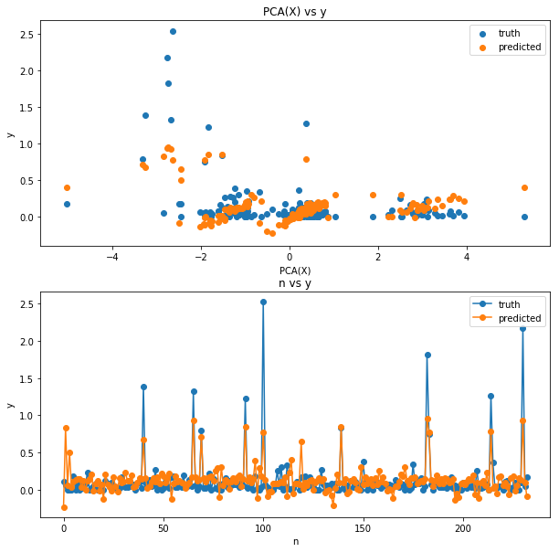
SGDRegressor
MAE: 0.129

Slide 15
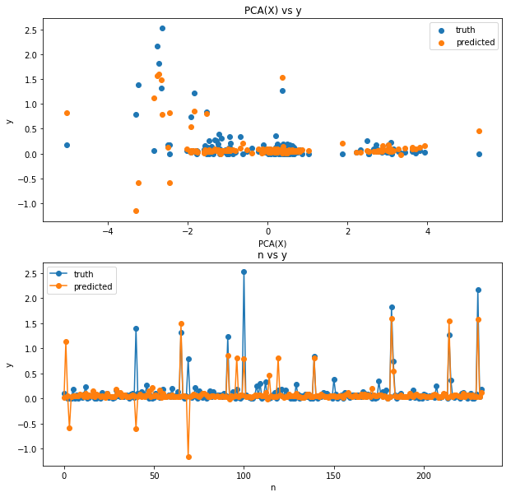
SGDRegressor with
3 degree polynomial
MAE: 0.093

Slide 16
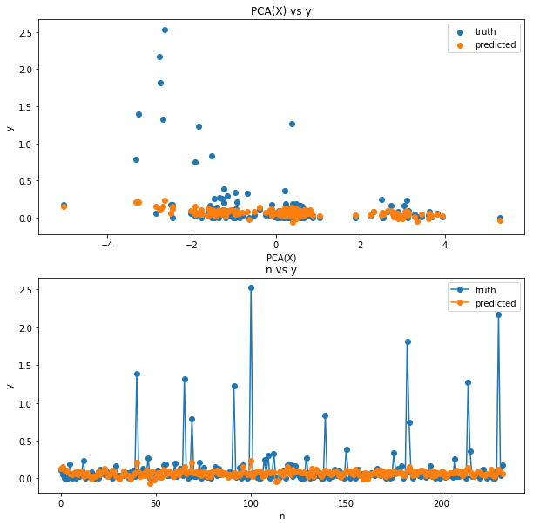
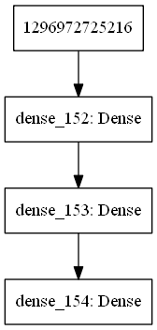
MLP
MAE: 0.14
10 features
2 neurons
2 neurons
1 output

Slide 17
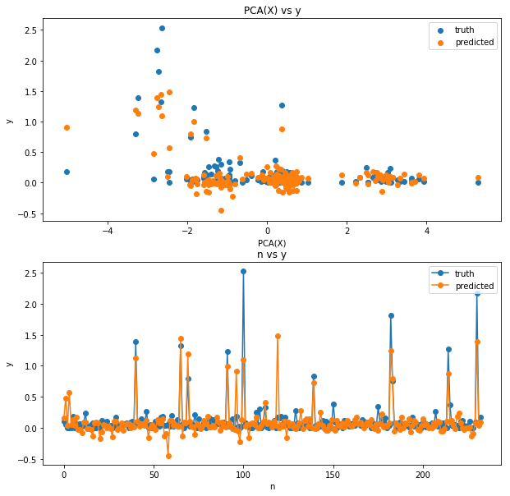
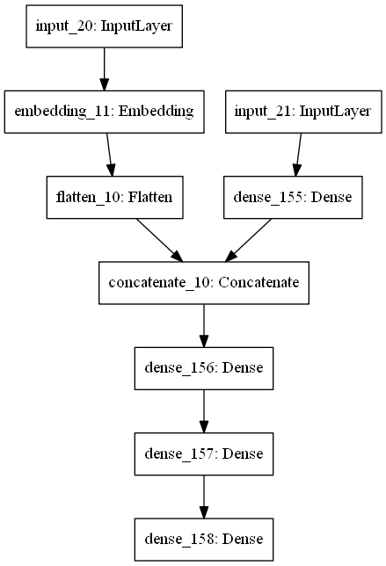
Word Embeddings
with MLP
MAE: 0.106
4 features
10 features
5 neurons
17 neurons
5 neurons
1 output

Slide 18
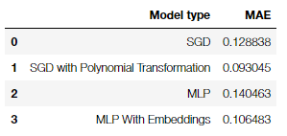
Best Model

Slide 19
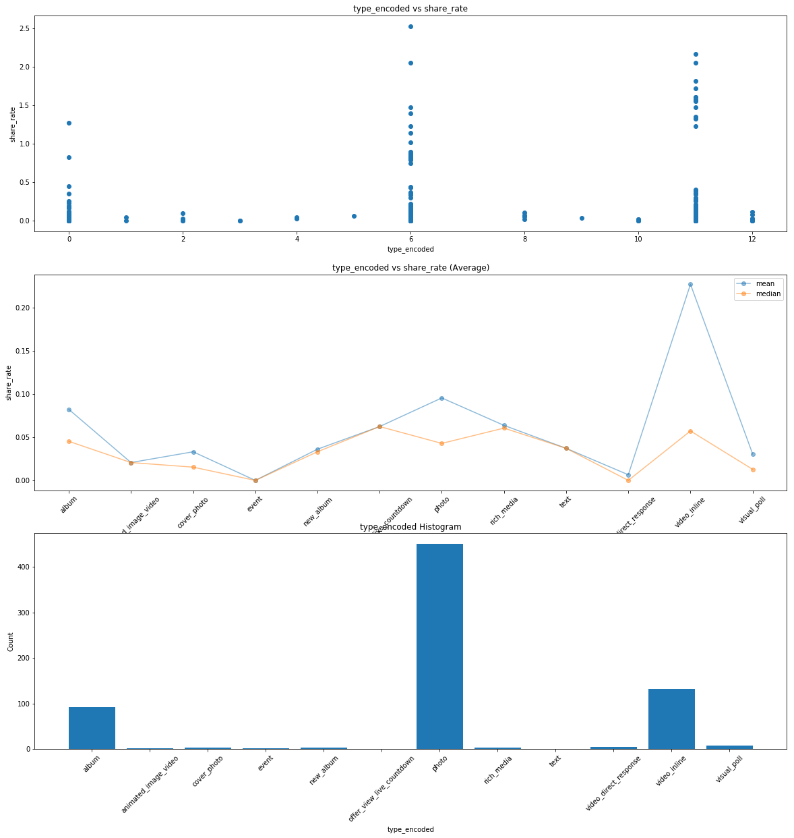
Gathering Insights
(Content Type)

Slide 20
Conclusions
The target numbers all hover around the same number, regardless of the features. This suggests that is not a good use case for ML?
It has been debated whether neural networks can perform for regression problems. For this case, it seems like it sometimes perform better than the normal regression models, so it's inconclusive
Data Insights:
A contest greatly boosts share rate
Paid amplification does not improve share rate significantly
Fridays is the best day to share a post
The optimal message length seems to be 400 and 700, but it is likely to be affected by other factors, so take it with a pinch of salt
The content within the test message affects share rate - The neural network with embeddings almost always performs better than the one without embeddings

